Slide 2
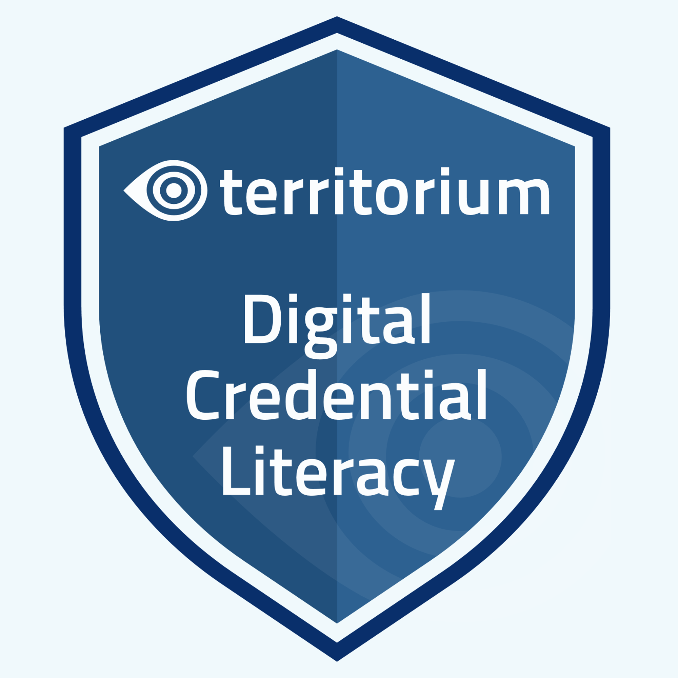

Slide 3
Learning outcomes
At the end of this training session you will
Understand the purpose of a digital credential and how verified credentials differ from traditional certificates or a resume.
Understand how to use a digital wallet to keep track of their learning.
Understand the importance of securing a digital wallet and managing interoperability between wallets.

Slide 4
A future with verifiable credentials
Defining Digital Credentials
Digital credentials showcase your skills earned over a lifetime.
These can help you find a career that fits your unique capabilities.
Notes:
In using the LifeJourney platform you will be able to earn digital credentials to help showcase your skills and find career opportunities. Let’s review some important concepts and terminology that you should know to use the application and future credentials.

Slide 5
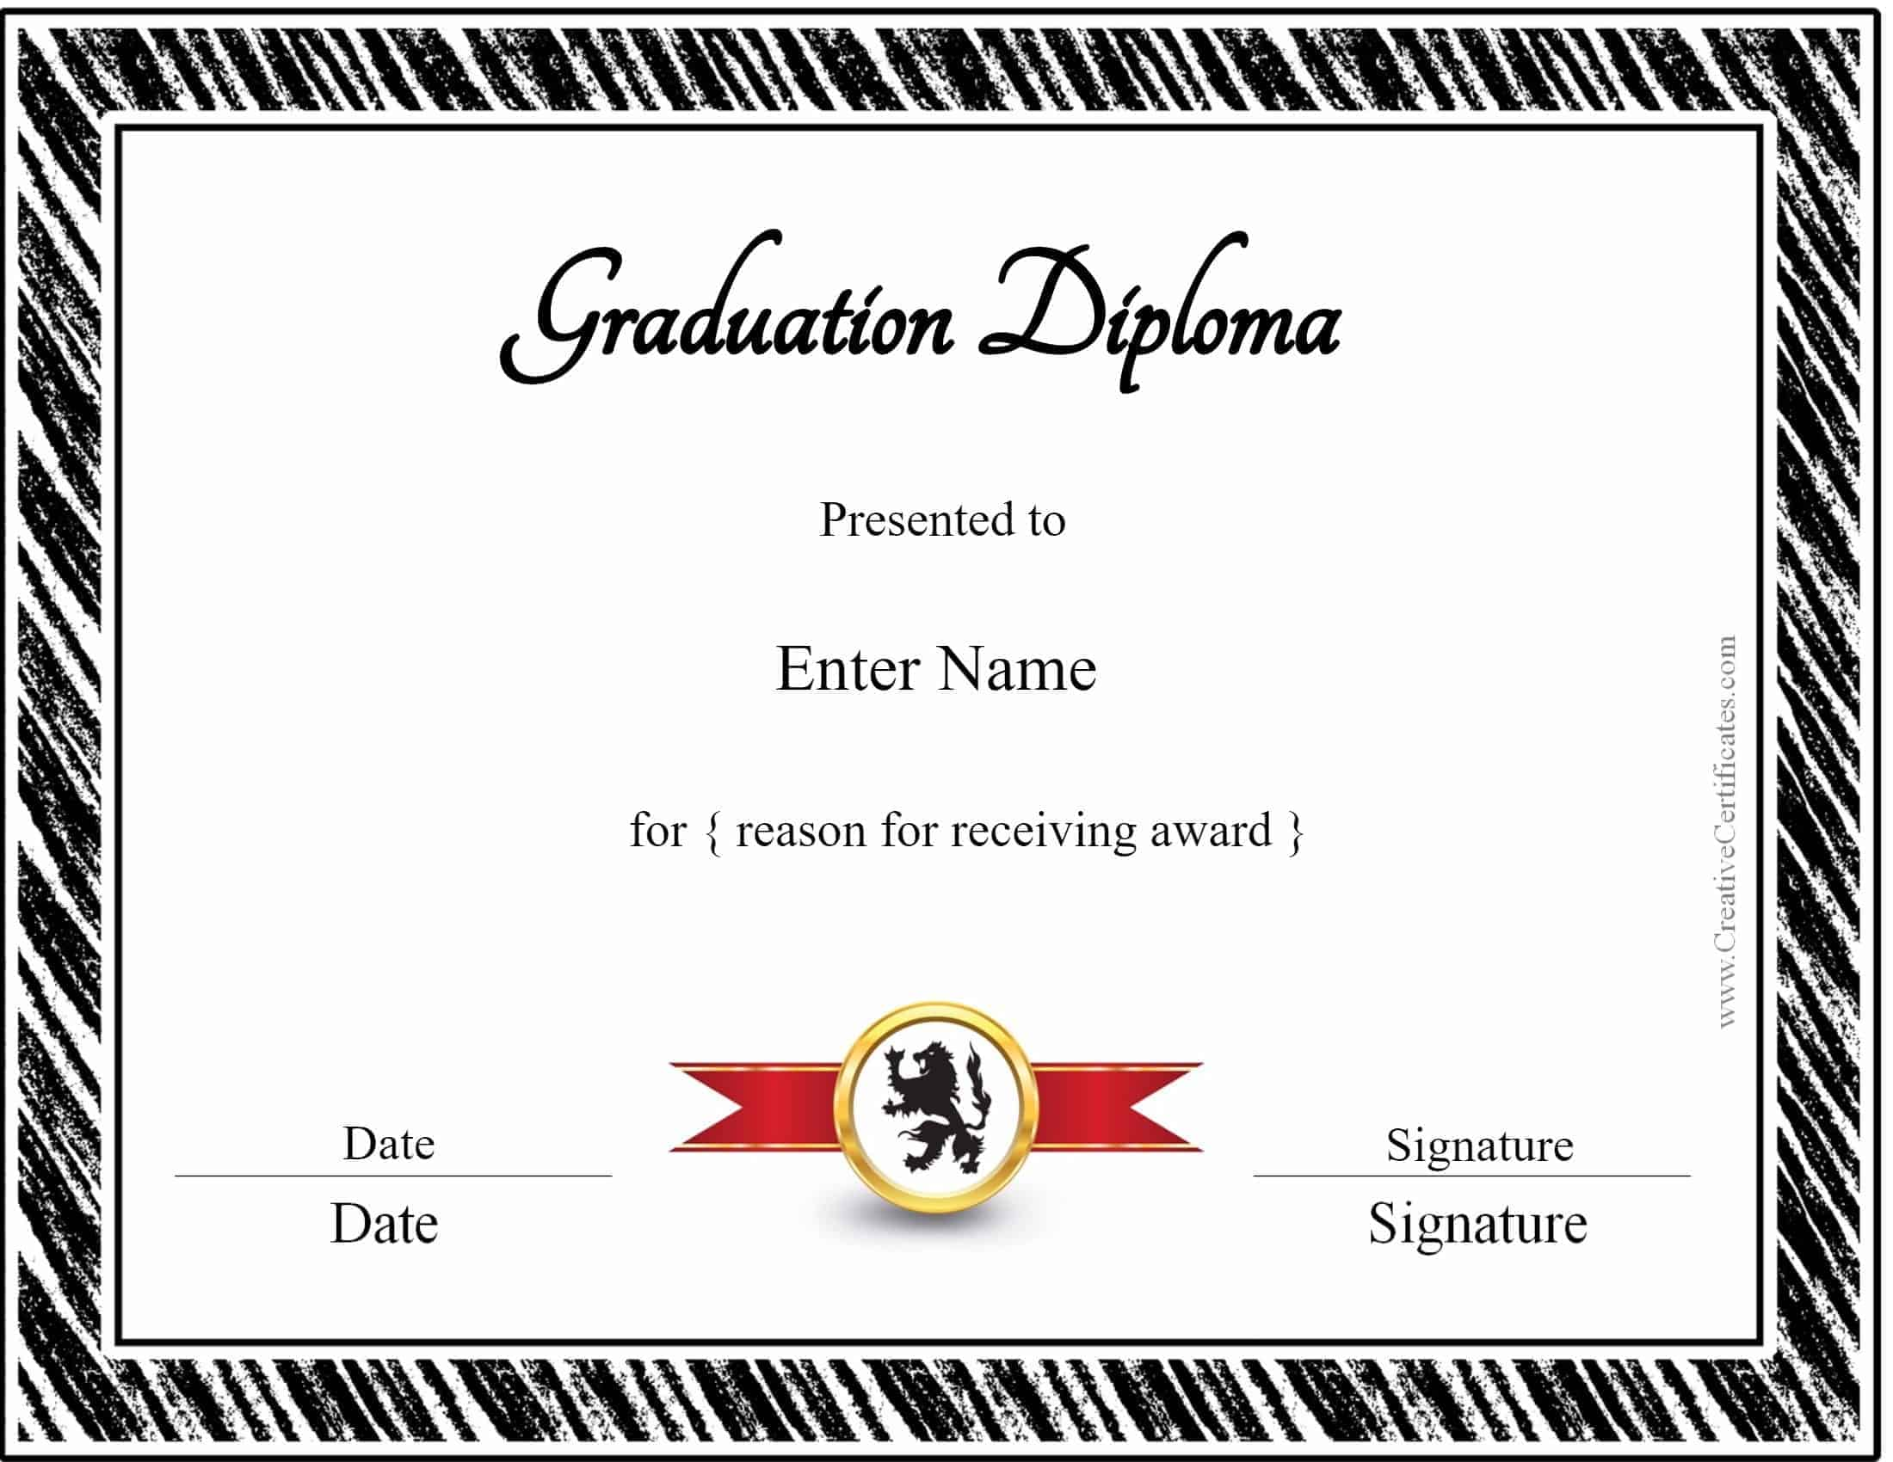
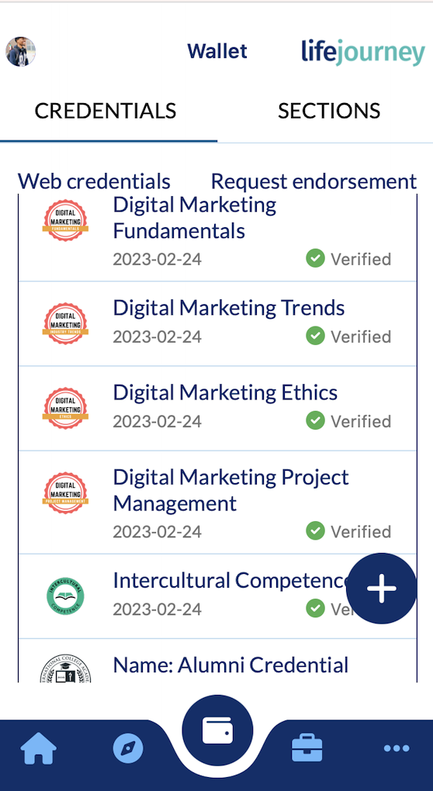
Educational credentials are changing
Defining Digital Credentials
Past: certificates of achievement, transcripts, diplomas…
Future: verifiable digital credentials
Notes:
In the past maybe you received a paper certificate of achievement for earning an honor or completing a workshop or class. Or if you completed a degree, like graduating from high school or college, you received a paper transcript with all your courses and grades and a diploma to hang on your wall.
Now there is a modern form of digital credentialing.

Slide 6
The Difference with Verifiable Credentials
Defining Digital Credentials
Past: certificates of achievement, transcripts, diplomas…
Future: verifiable digital credentials
Secure
Trustworthy
Tamper-proof digital signature
Verify authenticity and source
Can be forged or lost
Notes:
Educational institutions, training programs, or other learning providers can now issue verifiable credentials which let you can share your achievements with others in a secure and trustworthy manner.
Instead of relying on paper certificates or transcripts, which can be easily forged or lost, verifiable credentials are stored digitally and can be easily accessed and shared online.
The special thing about verifiable credentials is that they come with a digital signature, making them tamper-proof. This means that when you share your credential with someone, like a potential employer, they can verify its authenticity and ensure that it was indeed issued by a legitimate source.

Slide 7
Notes:
Learning can occur throughout your lifetime.
Whether it is in primary school, college, military service, full time employment, or in the home or in civic or community engagement.
A Comprehensive Learner Record or CLR shows a complete picture of lifelong learning, from the earliest stages of learning to advanced education to career achievements.

Slide 8
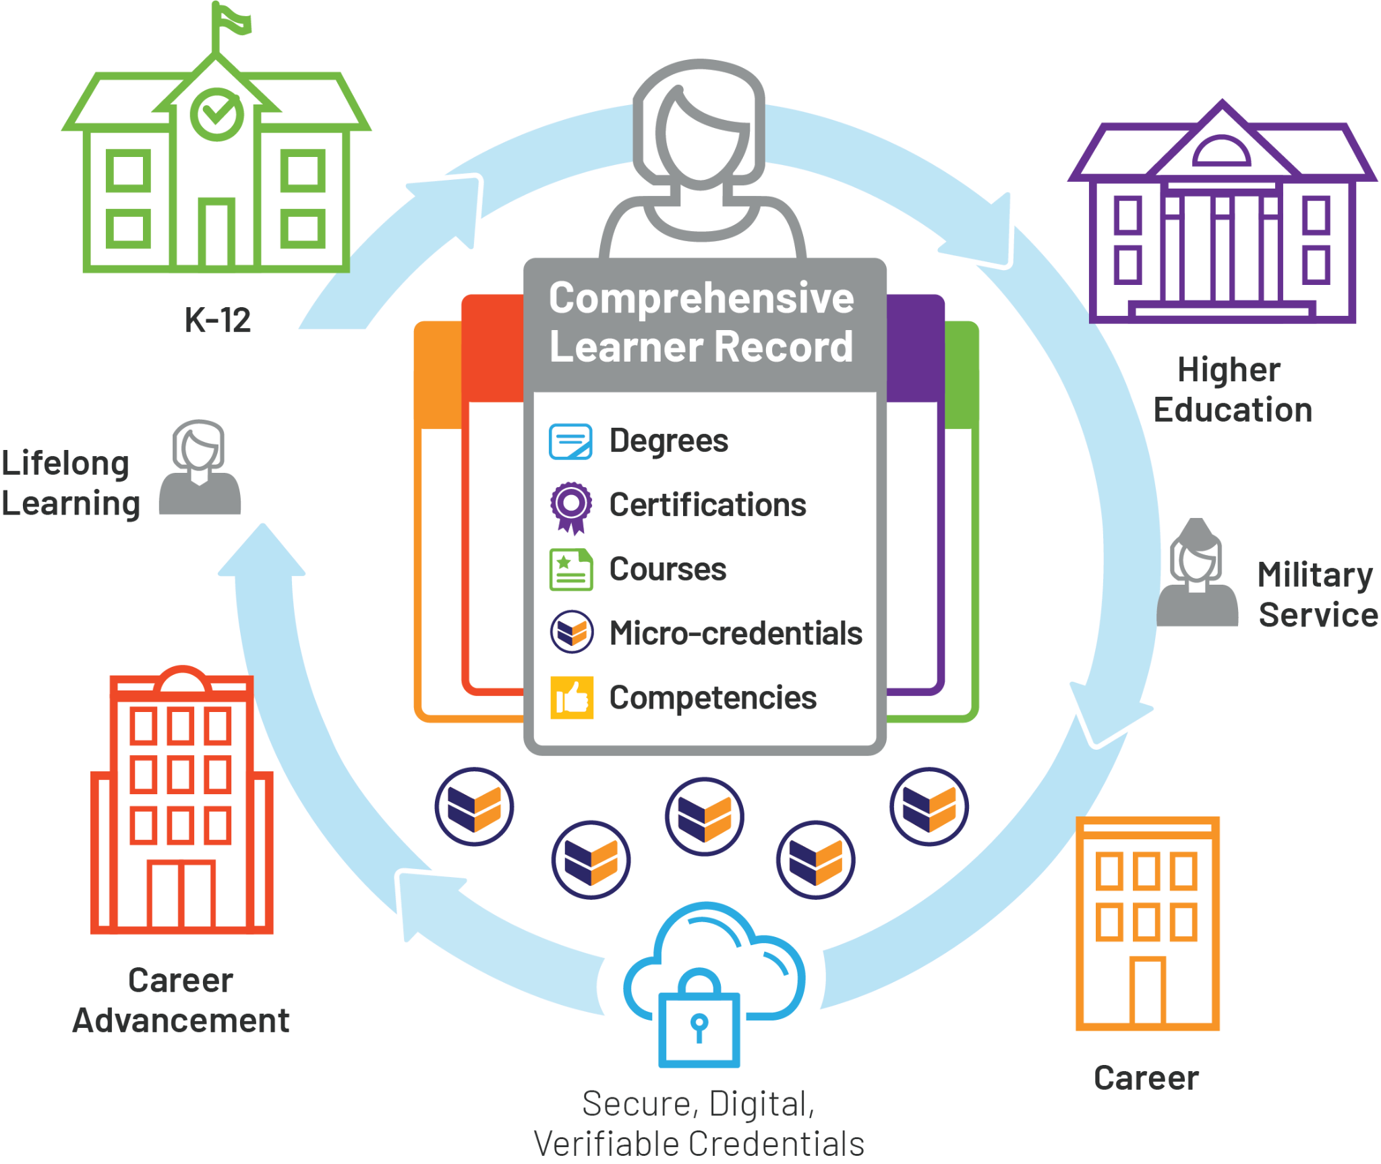
Digital Credentials Ecosystem
Notes:
The CLR is a digital record of all of your lifelong learning, whether it occurs through the attainment of degrees, certifications, or the completion of smaller events like courses, micro-credentials, or assessments of skill competencies.

Slide 9
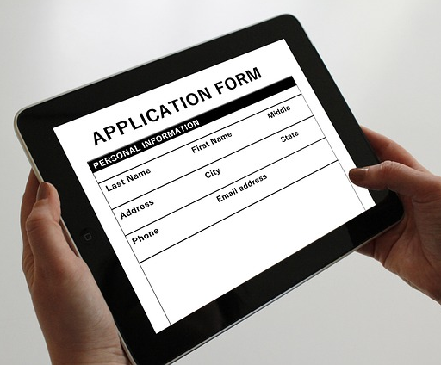
Uses of a CLR
Defining Digital Credentials
You might use a CLR credential when applying to a job or for a degree program.
Notes:
The CLR can contain your entire record of accomplishments and allow you to select which credentials you might want to present to others. For example, if you are applying for a job,

Slide 10
Uses of a CLR
Defining Digital Credentials
Select credentials for the right use case
Job application
Degree application
Notes:
perhaps you want to select only the degrees you have in the record, but not credentials for community volunteering.

Slide 11
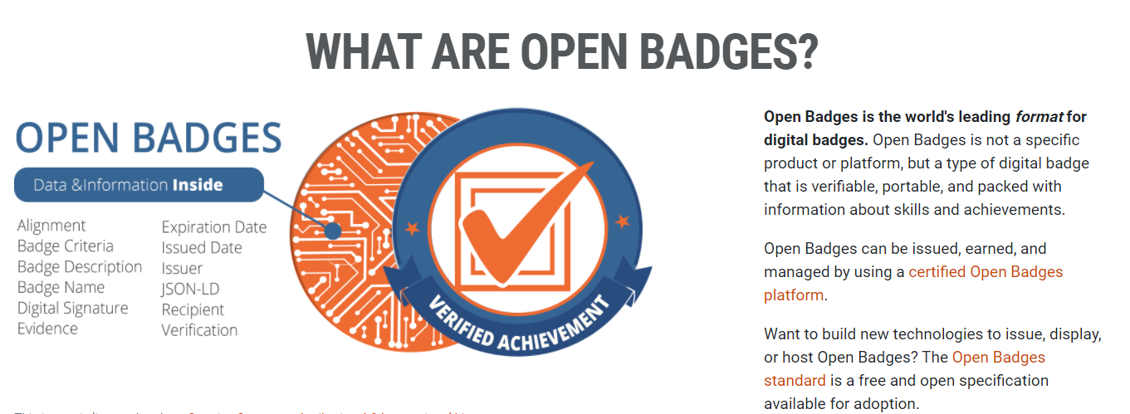
Open Badges (OB)
Notes:
Credentials can also be represented by what is called an Open Badge. Open Badges contain a visual representation of your achievement which often has the brand of the issuing organization and a name that conveys the badge’s meaning.
ANIMATE
But the badge is more than just a pretty picture. It contains important information such as the name of the credential, the issuer (the organization that provided it), the date it was issued or awarded, and any relevant details about your accomplishment or skill that a computer can read.

Slide 12
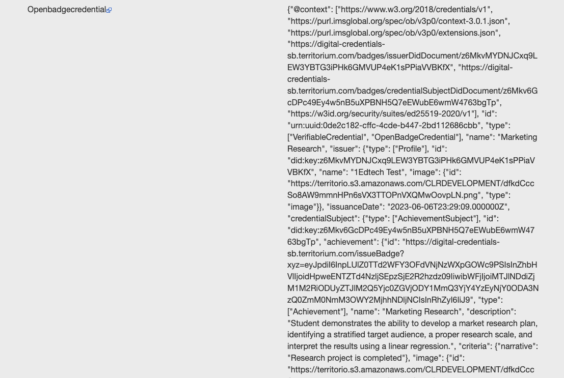
Baked Badges
Defining Digital Credentials
Images in the Open Badge can also contain the verified data.
Checked using a tool like https://exif.tools/ or another Open Badge validator tool
Notes:
In fact, in the process generating this data, even the badge images can be transformed into what is called a “Baked Badge” to put your credential information on the image itself.

Slide 13
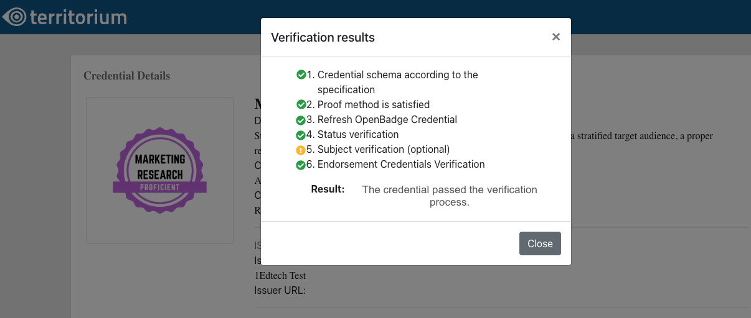
Open Badges and CLR
Defining Digital Credentials
Both types of credentials are verifiable and contain a tamper-proof digital signature.
Notes:
Both CLR credentials and Open Badges are verifiable. Meaning that they contain a digital signature that a computer can verify. Both are solutions that are tamper-proof, unlike traditional paper-based credentials.

Slide 14
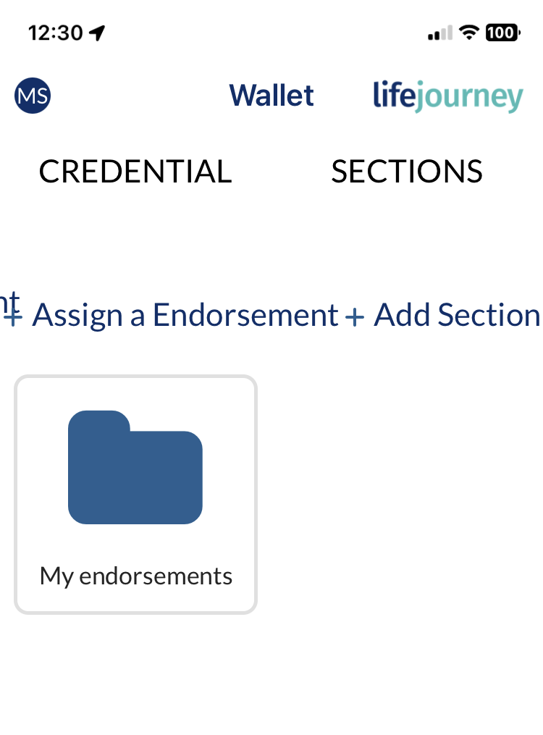
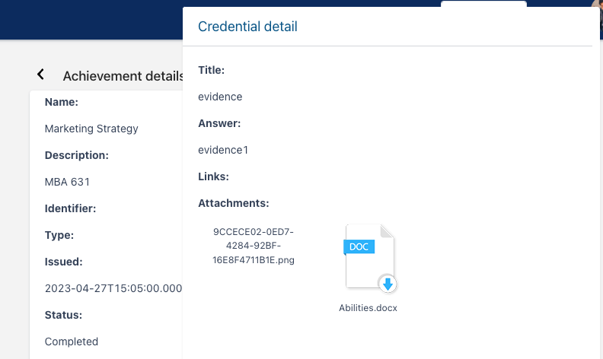
Open Badges and CLR
Defining Digital Credentials
They differ from paper credentials in that they can link to evidence and endorsements of the credential.
Notes:
Importantly they also differ from the prior paper credentials in that they can link to specific evidence and endorsements of the credential.

Slide 15
Open Badges are the most common term
Differences: Open Badges & CLR
75,000,000*
But they are used in a lot of ways from certifications for workshops to verifying a competency.
Open Badges Issued Worldwide
*Joint research of 1EdTech and Credential Engine as of 3Q 2022. 13 platforms reporting.
30+ Certified Platforms
Notes:
An Open Badge is likely the most common term you will hear to describe how organizations are issuing digital credentials. In fact, joint research from 1EdTech and Credential Engine estimate there are more than 75 million badges issued.
Badges can be issued for everything from simply completing a workshop or a free online course, a degree or verifying a skill competency.

Slide 16
Open Badges
Differences: Open Badges & CLR
Comprehensive Learner Record
Certificates of course completion
Honors and awards like winning a competition
Asserting a proficiency level on a skill assessment exam.
Illustrating all the courses to complete a micro-credential
Illustrating all of the courses to complete an academic degree
Listing all of the prior assessment scores to attain a competency level
List volunteer experience over time
Notes:
While Open badges are typically used for things like
Certificates of course completion
Honors and awards like winning a competition
Asserting a proficiency level on a skill assessment exam
A Comprehensive Learner Record (CLR) is used for things like
Illustrating all the courses to complete a micro-credential
Illustrating all the courses to complete an academic degree
Listing all of the prior assessment scores to attain a competency level
Or list all of your volunteer experience over time to show your skill in civic engagement

Slide 17
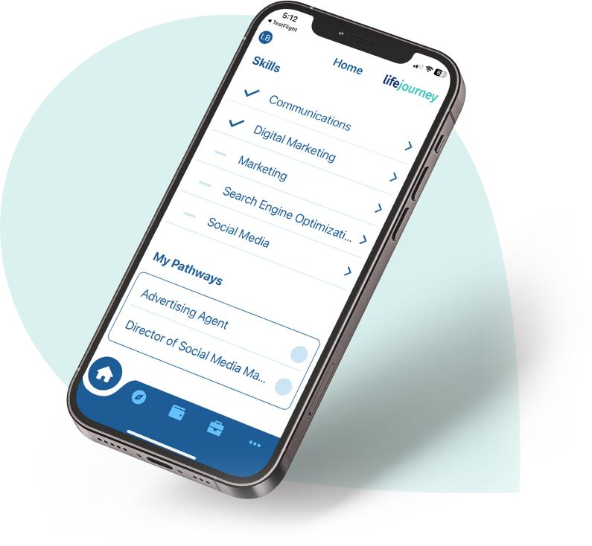
Your credentials are kept in a Digital Wallet
Differences: Open Badges & CLR
Store and access credentials
Decide how to share them
Generate verifiable CLRs for job or education applications
Notes:
All of these types of credentials are kept in a digital wallet so that you can easily store and access them. But also, so that you can decide with whom you would like to share individual open badges as evidence of your capabilities OR if you would like to generate a CLR credential to present many achievements to someone like a future employer or a school to which you are applying for admission.

Slide 18
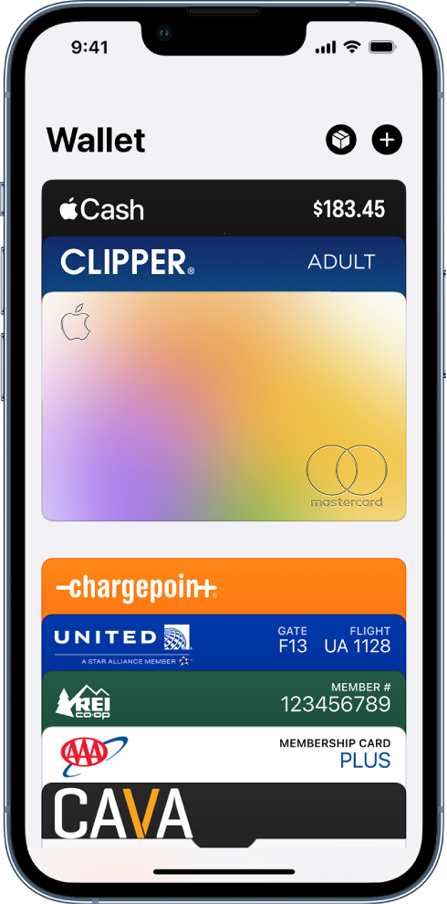
Digital Wallets for education
Differences: Open Badges & CLR
Storing your educational credentials is a similar concept to other types of digital wallets you might use.
Notes:
You might be used to using a wallet on your phone to store payment options like a credit card, or to store movie or plane tickets.
Digital Wallets that store your CLR and Open Badge credentials are a similar idea.

Slide 19
Accepting badges
Importing badges
In managing credentials from multiple sources
You are likely to have many wallets with different badges
Example: Each school my have their own wallet with issued credentials.
Make sure to accept badges when they are awarded.
Save them to a wallet.
Notes:
Manage your credentials from various sources:
It’s likely that over your lifetime you will get credentials, whether CLR or Open Badges, from different places such as your school or online providers like Udemy or Coursera.
For example, if you attend different schools or use online training sites, you'll have multiple credentials.
Don't leave them in your email; accept and store them in a wallet if available.

Slide 20
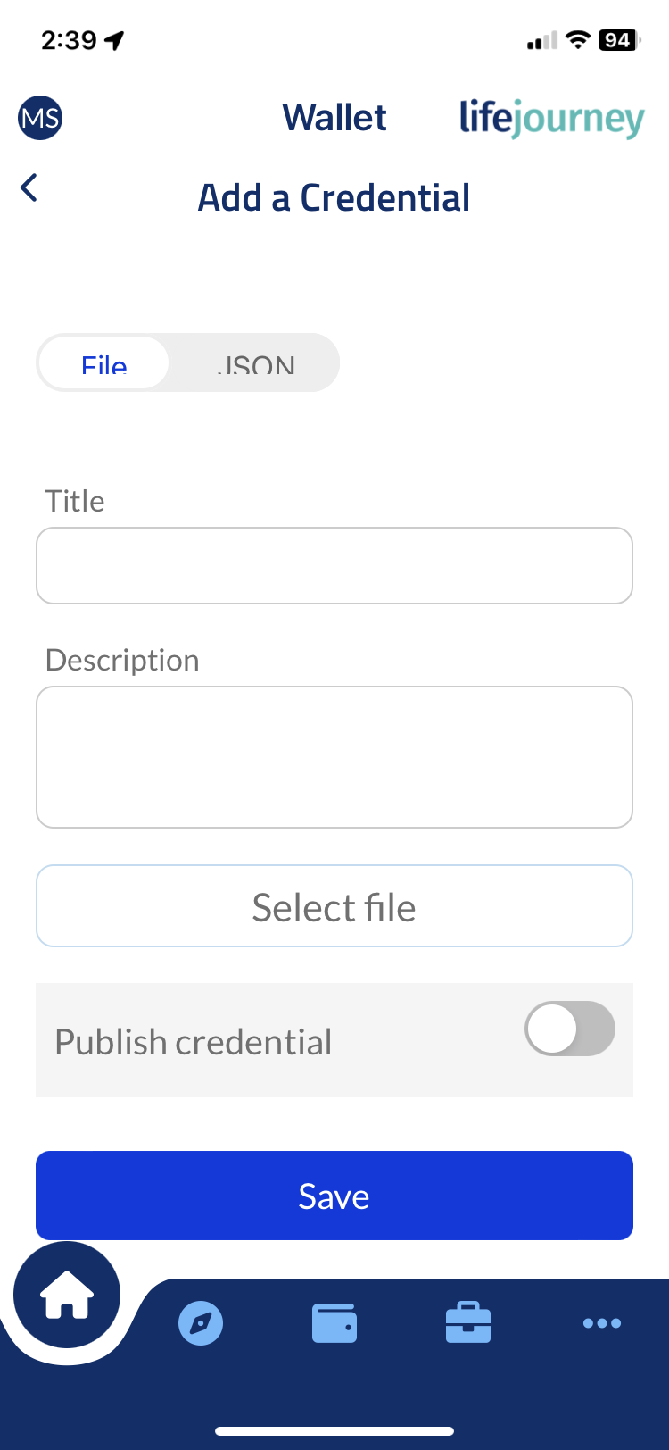
Importing credentials
Importing badges
Upload other credentials to your LifeJourney wallet.
Simple digital images of certificates or PDFs use the file import.
Or, from your other badging provider you can get the badge code and use the JSON option.
Notes:
Some wallet providers, like Territorium, allow you to import your credentials from other places either by uploading an image of it or getting the actual code from the badging platform.

Slide 21
Wallet Security
Importing badges
Protect your digital identity & credentials
Use strong passwords
Securely store username & passwords
Avoid unknown links or downloads
Prevent compromising your devices or email
Notes:
Ultimately, it is your choice how you manage your badges.
Your educational credentials are an important part of your digital identity and can identity who you are. Mishandling of that information can allow people to impersonate you.
It is important to protect your digital identity and credentials:
Safeguard access credentials and use strong passwords.
Securely store usernames and passwords.
Handle emails from issuing organizations securely, avoiding unknown links or downloads
Mishandling information can lead to impersonation, so be cautious to prevent compromising your devices or email.

Slide 22
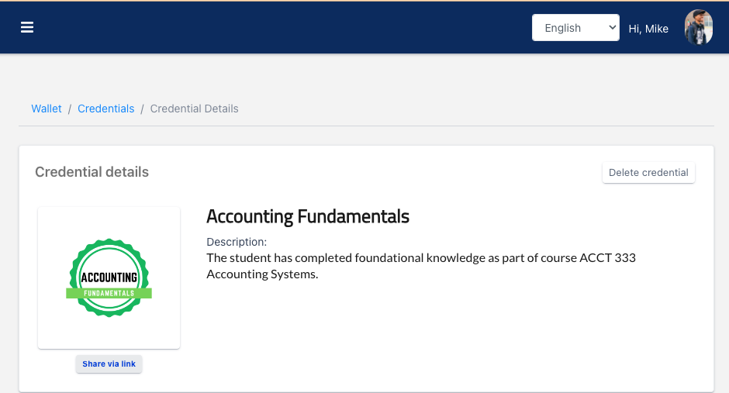
Be careful when sharing a badge publicly!
Importing badges
Avoid sharing baked images
Don’t use the verifiable URLs; use the social media link or public link
Share only with trusted platforms
Check privacy settings
Notes:
When you get a badge, the platform often gives you the ability to share it to let others know you have obtained a new skill.
When sharing a badge online, be cautious:
Avoid sharing baked images that contain all verification data; check for embedded information or interactive elements by hovering over the image.
Refrain from publicly posting verifiable URLs; reserve them for employers or educational institutions during applications.
Share information only on trusted platforms.
Review and adjust privacy settings as needed.

Slide 23
Activity Completion
Earn your badge!
Notes:
Congratulations! Now you know all about digital credentials and how to use them!

Slide 24
Take the Digital Credentials Literacy Quiz
Earn your Badge
Earn a 70% or better (7/10) as a passing score.
A link to the survey is in the Success Center.
Notes:
Visit the Success Center. On the page for the Digital Credentials Literacy training you will find a link to complete the survey.
Once the administrator reviews your scores your badge will be issued if you earn our passing score of 70%.

Slide 25
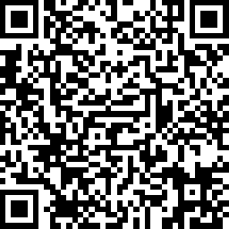
Take the Digital Credentials Literacy Quiz
Earn your Badge
https://www.surveymonkey.com/r/CLRquiz

Slide 26
Congratulations!
You have earned your badge!

